Slide 1

RAILTEL SAFETY SOLUTIONS
D. Nohith Reddy
P. Sathvika
P. Hema Dikshitha Priya
Guide : Mrs. D . Padmaja Usharani

Slide 2
PROBLEM STATEMENT
Develop a comprehensive safety solution for RailTel, a telecommunications infrastructure provider for the Indian Railways, to address the challenges associated with ensuring the safety and security of railway assets, personnel, and passengers. The solution should integrate advanced technologies such as IoT, AI, and machine learning to proactively detect and prevent potential safety hazards, mitigate risks associated with accidents, trespassing, vandalism, and unauthorized access, and enhance overall operational efficiency and passenger experience across the railway network.

Slide 3
INTRODUCTION:
Railway transportation plays a critical role in the economy and connectivity of nations, facilitating the movement of passengers and goods across vast distances. However, ensuring the safety and efficiency of railway operations is paramount to prevent accidents and disruptions. RailTel Safety Solutions aims to leverage advanced technologies, including Lidar sensors, to enhance safety measures and operational efficiency within the railway industry.
BACKGROUND:
Traditional safety systems in railways rely on manual inspections and limited sensor technology, which may not always provide timely or accurate detection of hazards. With the advent of Lidar sensors, there's an opportunity to revolutionize railway safety by employing cutting-edge detection and monitoring capabilities. Lidar offers high-resolution, real-time data capture, enabling precise detection of obstacles, track deformities, and other potential risks along the railway network. By integrating Lidar technology into RailTel safety solutions, we can augment existing safety measures and mitigate risks associated with railway operations.

Slide 4
PURPOSE OF THE PROJECT:
The primary purpose of the RailTel safety solutions project is to enhance railway safety and operational efficiency through the implementation of advanced Lidar-based technologies. This project aims to achieve the following objectives:
1. Risk Mitigation: Reduce the likelihood of accidents, collisions, and derailments by detecting and alerting railway operators to potential hazards in real-time.
2. Operational Optimization: Improve the reliability and efficiency of railway operations by providing actionable insights derived from Lidar data, enabling proactive maintenance and infrastructure management.
3. Regulatory Compliance: Ensure compliance with railway safety regulations and standards by implementing state-of-the-art safety systems that meet or exceed industry requirements.
4. Cost Reduction: Minimize operational costs associated with maintenance, repairs, and downtime by preventing accidents and disruptions through early detection and intervention.
5. Enhanced Passenger Safety: Enhance the safety and security of passengers and railway personnel by deploying advanced safety solutions that mitigate risks and provide timely warnings in the event of emergencies.

Slide 5
SCOPE:
The scope of your RailTel safety solutions project can be comprehensive, encompassing various aspects of railway safety and operational efficiency. Here's a breakdown of potential scope elements:
1. Safety Systems Implementation
2. Data Collection and Analysis
3. Technology Integration
4. Real-time Monitoring and Alerting
5. Maintenance Planning and Management
6. Regulatory Compliance
7. User Interface and Visualization
8. Training and Support
9. Scalability and Future Expansion
10. Partnerships and Collaboration

Slide 6
METHOD:
To successfully implement our RailTel safety solutions project, we have followed the following methods:
1. Project Planning and Requirements Gathering
2. Technology Evaluation and Selection
3. System Design and Architecture
4. Prototype Development and Testing
5. Pilot Deployment and Validation
6. Refinement and Optimization
7. Full-Scale Deployment and Rollout
8. Monitoring, Evaluation, and Continuous Improvement

Slide 7
LITERATURE REVIEW:
Our research involved studying various existing mechanisms for obstacle detection and avoidance in robots. Detecting and avoiding obstacles is critical for the safety and functionality of autonomous mobile robots operating in uncertain environments. While humans find obstacle detection intuitive, it poses significant challenges for robots.
In our review, we found a wide array of sensors and algorithms proposed for obstacle detection and avoidance. Ultrasonic sensors emerged as a common choice for detecting obstacles due to their reliability and affordability. Additionally, vision systems have been instrumental in enhancing a robot's capabilities for complex tasks.
One notable project, "Avoidance of Railway Accidents," focused on developing a wheeled autonomous platform capable of avoiding obstacles. This platform, designed for educational, research, or industrial purposes, serves as a versatile tool for learning microcontroller programming, sensor characteristics, and motor control.
we will leverage ultrasonic range finders to detect and map obstacles, thereby preventing collisions. By incorporating sensors and algorithms inspired by previous research, we aim to create a robust obstacle-avoidance system tailored to the specific requirements of our project.

Slide 8
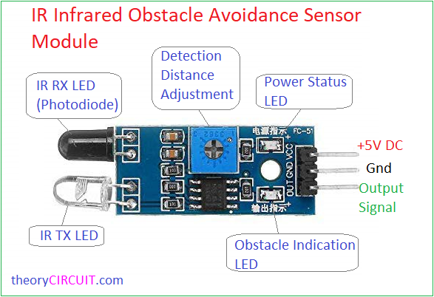
Some live images :
IR Infrared Obstacle Sensor Module
This Sensor module sends Infrared light (which can’t seen through naked eye) through IR LED and detects bounce back or Reflected Infrared light waves from objects with IR Receiver (Photo diode). Here Current flow from photodiode differs according to the Received IR light. IC LM393 comparator gives output with respect to voltage from Variable Resistor (Detection Distance Adjustment) and IR Receiver diode. On IR sensor module there is a output LED which indicates the detection of obstacle. If LED ON – obstacle detected or LED OFF – no obstacle in range. We can use this module as Digital output sensor or Analog output Sensor with changes in Arduino Wiring and Code.

Slide 9
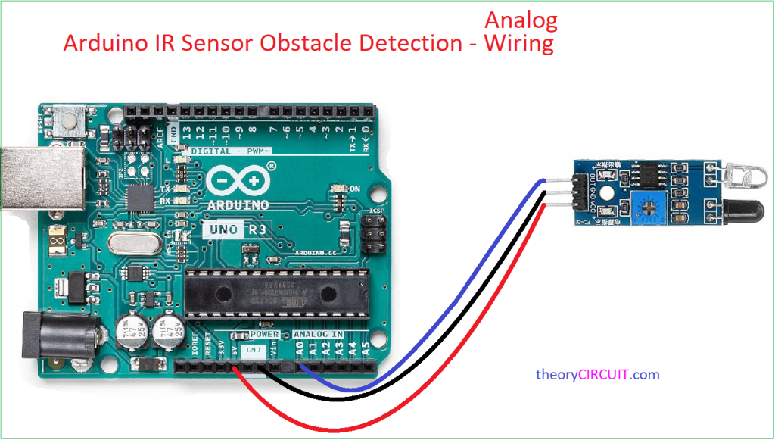
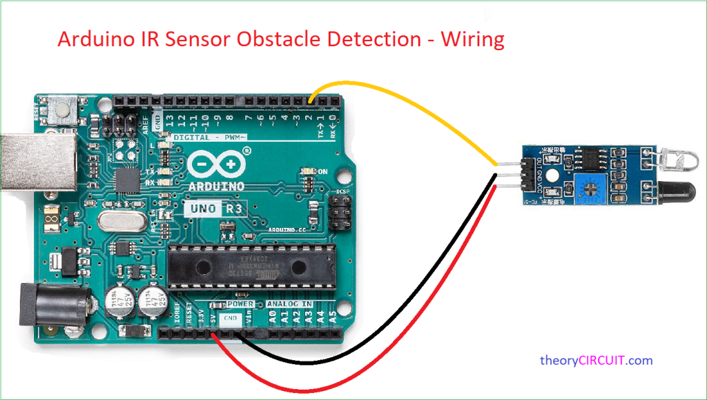
Arduino IR Sensor Module Wiring
For Analog Output
For Digital Output

Slide 10
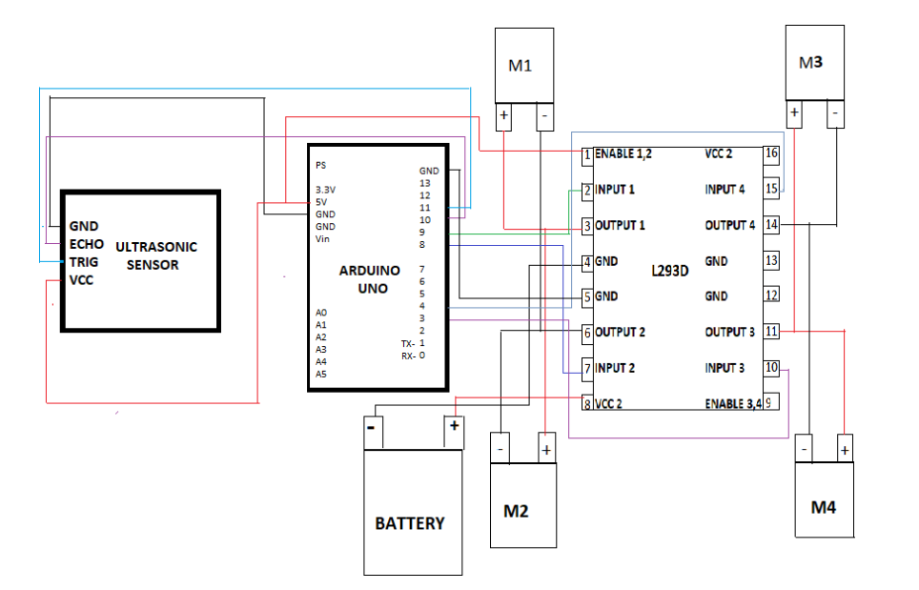
Design:

Slide 11
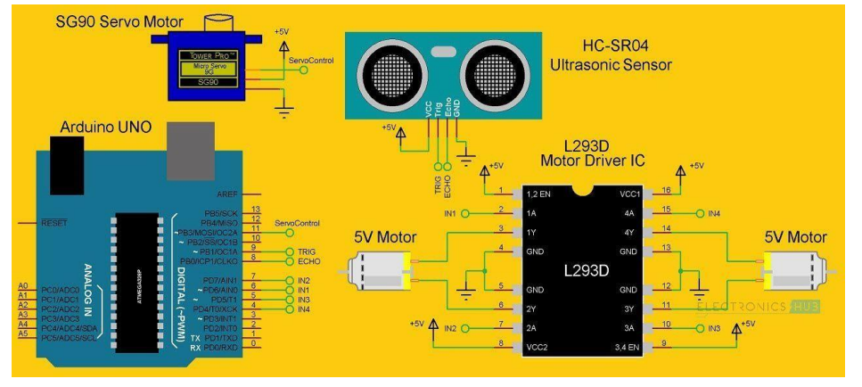
Block Diagram:

Slide 12
Working:
The obstacle avoidance robotic vehicle uses ultrasonic sensors for its movements. Arduino is used to achieve the desired operation. The motors are connected through motor driver IC to Arduino. The ultrasonic sensor is attached in front of the robot.
Whenever the robot is going on the desired path the ultrasonic sensor transmits the ultrasonic waves continuously from its sensor head. Whenever an obstacle comes ahead of it the ultrasonic waves are reflected back from an object and that information is passed to the arduino. The arduino controls the motors left, right, back, front, based on ultrasonic signals. In order to control the speed of each motor pulse width modulation is used (PWM).
When ultrasonic sensor detect the object which is kept inside the path it will send the signal toward the arduino uno and according to that it will it will rotate the motor M3 & M4 in forward direction and rotate the motor M1 & M2 in reverse direction such way that the car get moving in left direction .
Similarly in every time when ever an obstacle in found to be in path of car it will detect it and rotate the car in left direction to avoid the obstacle.

Slide 13
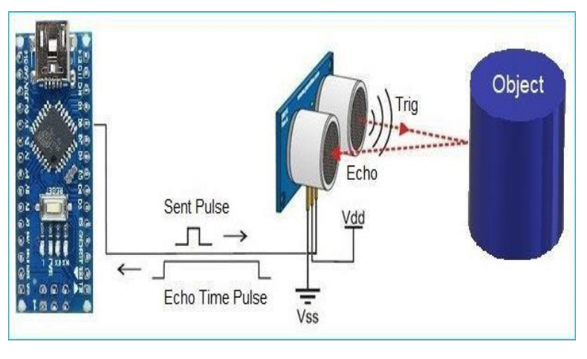

Slide 14
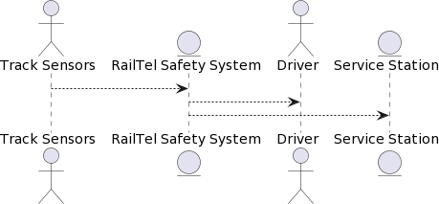
Flow-Chart (Hardware Implementation):
The below shows the flow-chart that describes the process for the designing and development of the hardware. The hardware implementation phase is divided into five components. The components are the LEDs and LDRs, comparator ,microcontroller [(Hardware Implementation) ,motor driver and the motor , in sequential order. Each component has been explained below along with their circuital representation as used in the building of the robot. The software implementation is included in the microcontroller phase.

Slide 15
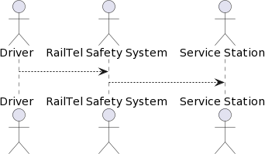
USE CASE DIAGRAM

Slide 16
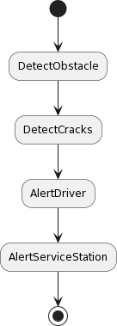
ACTIVITY DIAGRAM

Slide 17
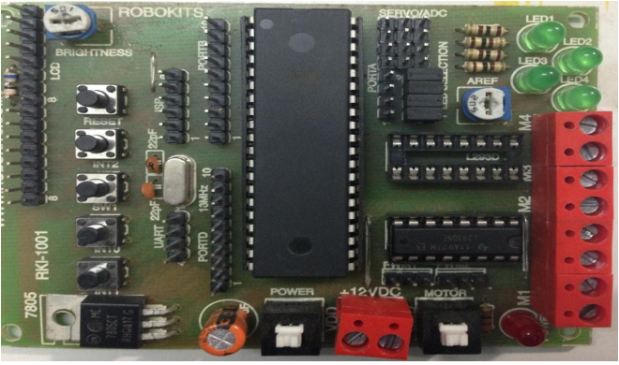
Microcontroller:
The picture shows the AVR 40 pin rapid robot controller board with ATmega32 Microcontroller. The controller board is used to communicate with the PC using serial communicator (USB connection) and is used during the programming phase that shall give the robot its reactive control law features. We used the port A to supply input that we got from the output of the comparator and then the output was sent out from port B to the motor driver. The ports C and D were not used for the Obstacle detection and Avoiding Robot

Slide 18
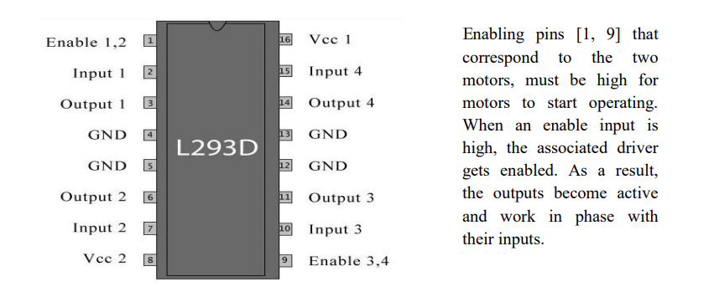
Motor Drivers (L293D IC):
Motor drivers take a low current control signal but provide a higher current signal, thus acting as a current amplifier. The higher current signal drives the motors. L293D is a motor driver that allows direct current (DC) motor to drive on either direction. It contains two inbuilt H-bridge driver circuits [21]. To rotate the motor in clockwise or anticlockwise direction, voltage need to change its direction. H-bridge is a circuit that allows voltage to be flown in either direction. Hence H-bridge IC are ideal for driving a DC motor [20]. While operating in its common mode, it can drive two DC motors simultaneously, in forward as well as reverse direction. The motor operations can be controlled by input logic at pins [2, 7] and [10, 15]. Input logic signal 00 or 11 will stop the motor. Logic 01 will rotate it in clockwise direction and 10 in anticlockwise directions

Slide 19
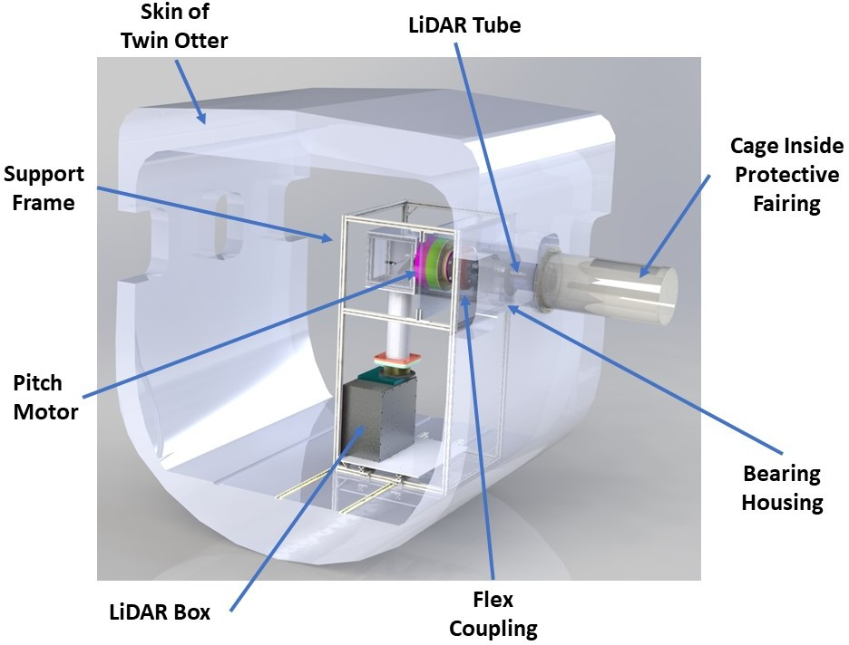
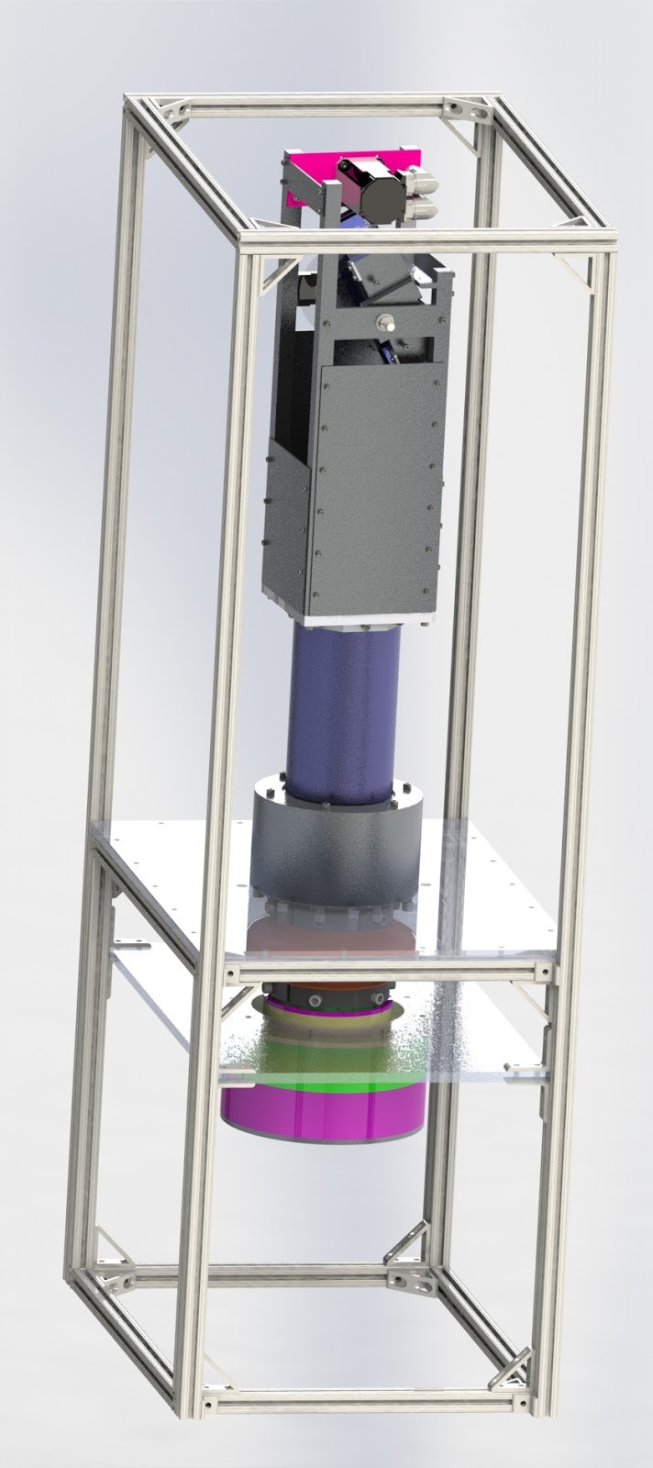
Lidar (Light Detection and Ranging) sensors can be a valuable component in RailTel safety solutions. Here are some potential applications and benefits:
1.Obstacle Detection
2. Track Monitoring
3. Level Crossing Safety
4. Tunnel Monitoring
5. Collision Avoidance Systems

Slide 20
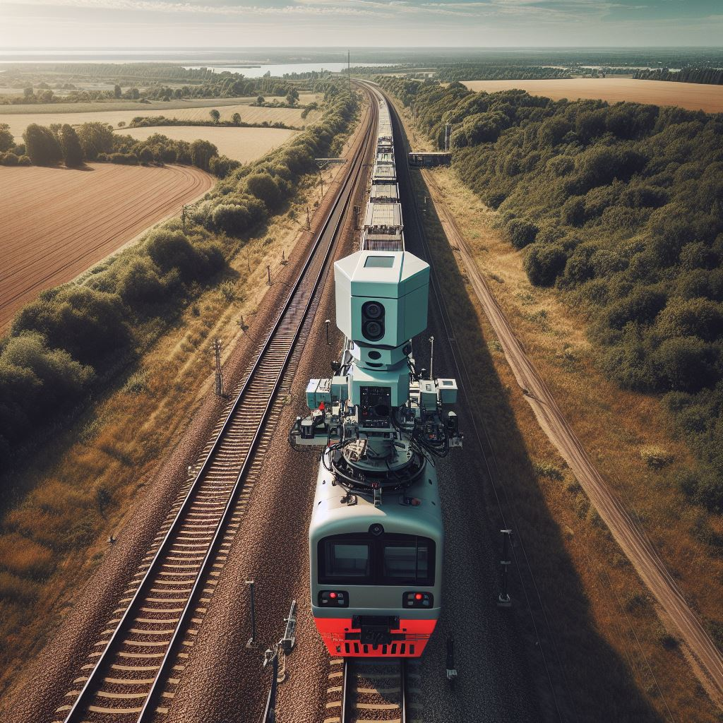
LIDAR (LIGHT DETECTION AND RANGING) SENSORS ON TOP OF THE TRAIN

Slide 21
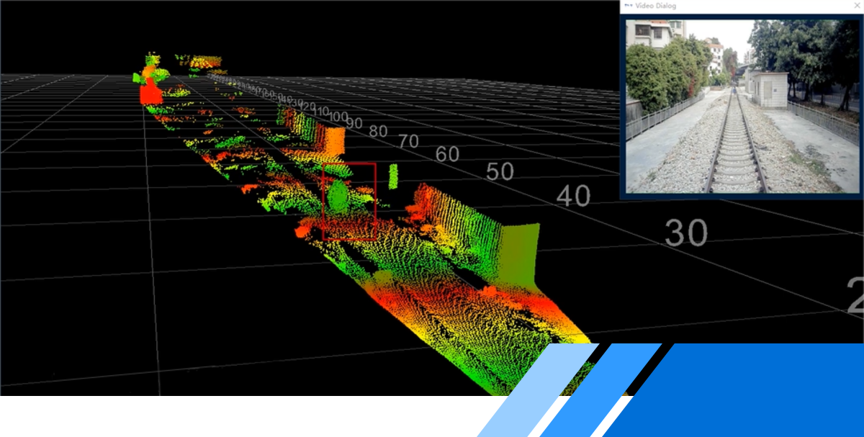

Slide 22
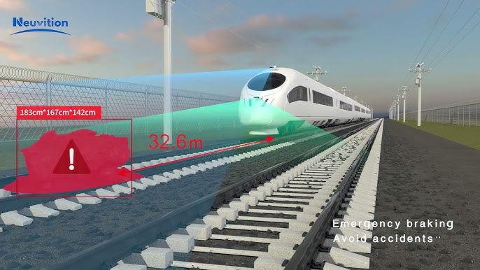

Slide 23
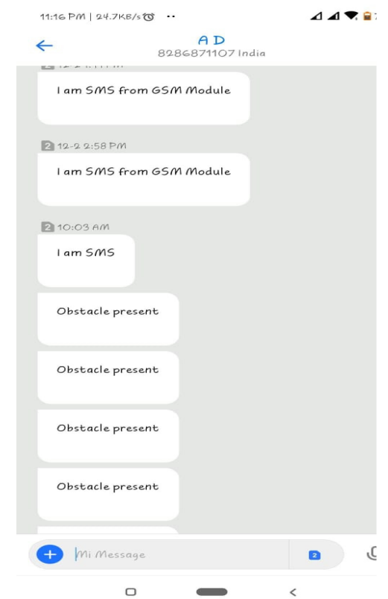
RAILWAY TRACK – OBSTACLE DETECTION
We have to make sure that the connection is established between microcontroller and GSM. There are two ways of doing it, one is to connect TX pin of GSM to RX pin of microcontroller and RX pin of GSM module to TX pin of microcontroller. Second is by selecting two PWM enabled pins of microcontroller (Pin 9, 10). It uses software serial library of microcontroller, when the connection is established, the data can be fed directly to GSM.

Slide 24
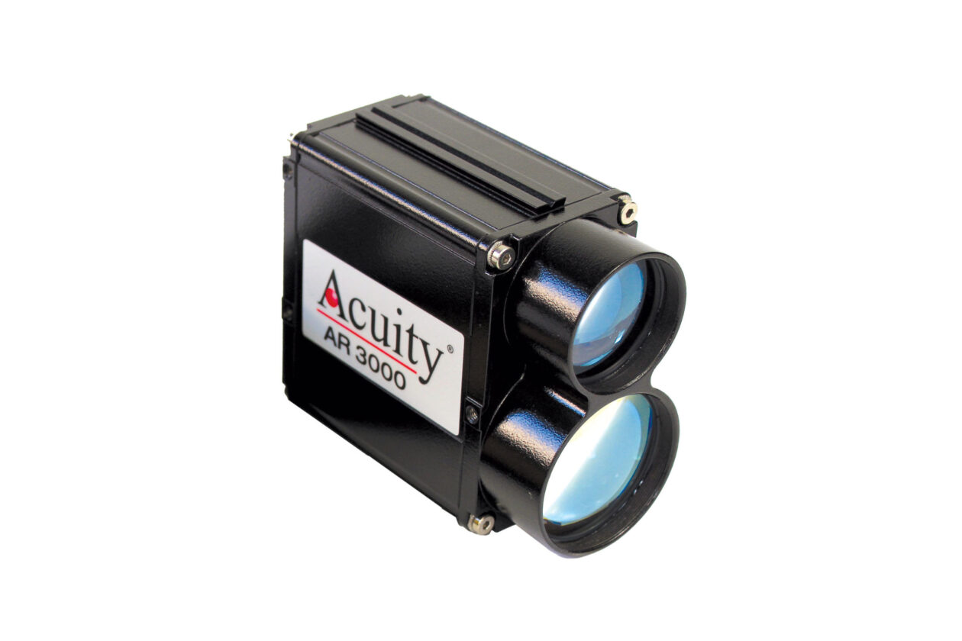


AR3000 DISTANCE MEASUREMENT SENSOR
AR3000 distance measurement sensors are Acuity’s longest-range models. Ideal for measuring positions of cranes and trolleys, the time-of-flight sensor can measure up to 300 meters to natural surfaces and up to 3,000 meters when using a retroreflective target.
The eye-safe laser and robust enclosures design (NEMA-4, IP67) make it a versatile choice for industrial measuring applications.
The AR3000 has an operating temperature of -40 to 60 °C [-40 to 140 °F] and has a built-in heater that will automatically turn on/off when limits are exceeded.

Slide 25
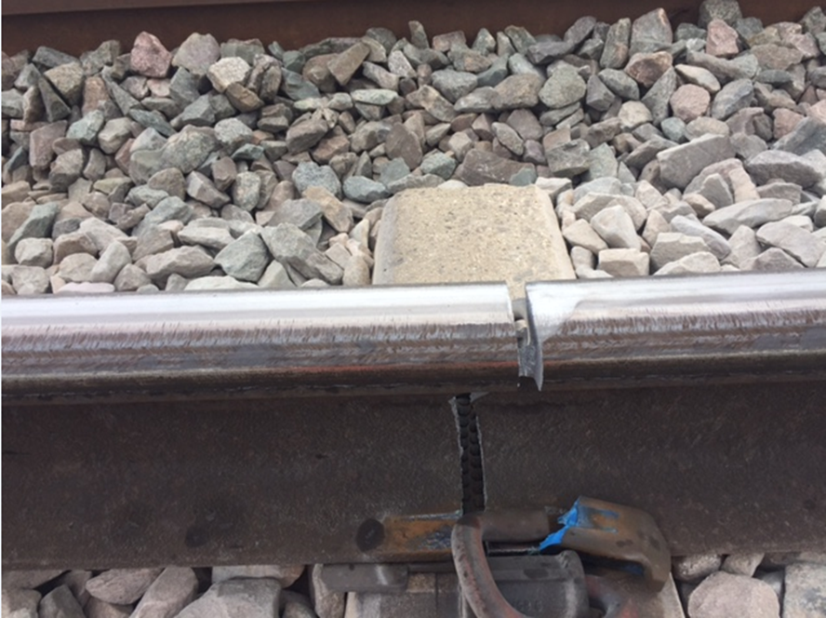
A survey on the internet states that about 60% of all the railway accidents is due to derailments, recent measurements shows that about 90% are due to cracks on the rails.
System having LED and LDR sensor assembly, but the main disadvantage is that the LED and LDR must be placed opposite to each other and also the environment needs to be perfect to detect the track. To overcome this disadvantage, here sensors are used, which will detect the crack accurately. The existing system is slow, tedious and time consuming. This system has GSM and GPS module which will give the real time location or coordinates in the form of Short Message Service (SMS) to the nearest railway station.

Slide 26
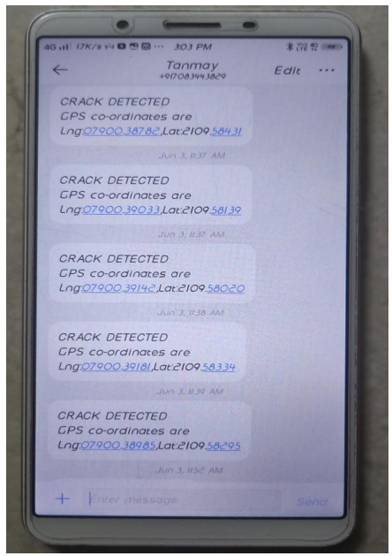
RAILWAY TRACK – CRACK DETECTION
Ultrasonic sensor performs its operation scanning and detecting the cracks on the track, when the crack is detected, it will stop the vehicle. Now, GPS will operate getting the coordinates of the location. So, now GSM Module comes into picture which operation is to transmit message to the control room of railway. So, GSM will send a message as ''Obstacle Present" as shown in Figure 4 to the predetermined location. When both the messages are sent and the program will go again on the initial stage and the motor will start again, and it will scan the track.

Slide 27
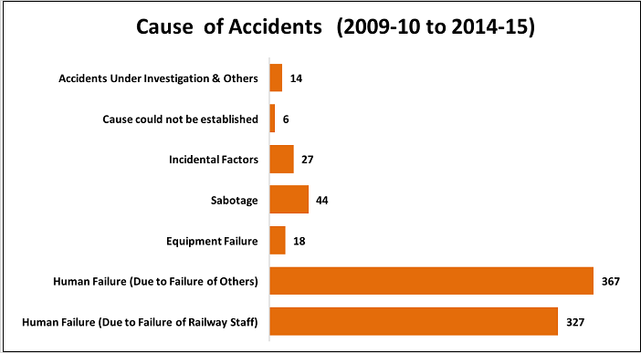
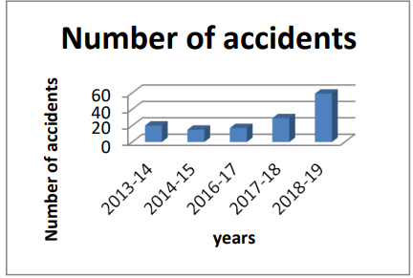
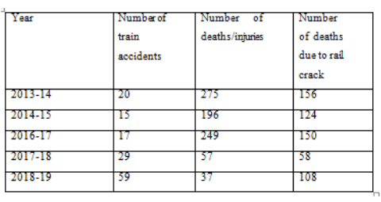

Slide 28


